Slide 1
AI ETHICS

Slide 2
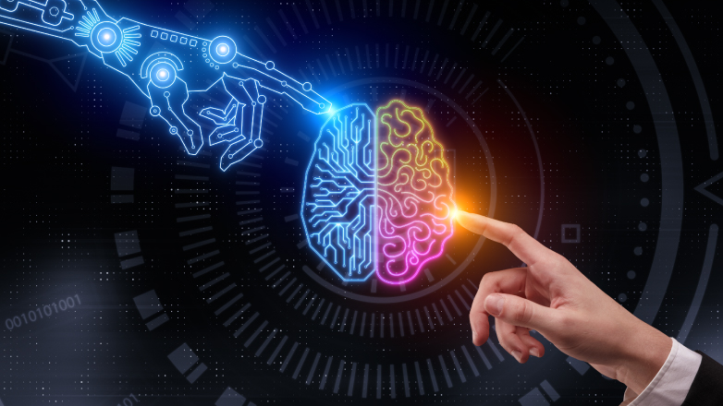
OUTLINE
Long Term Ethics (How do we deal with conscious AI)
Short Term Ethics (Unconscious AI’s effects on Humans)

Slide 3
3 Levels of Consciousness

Slide 4
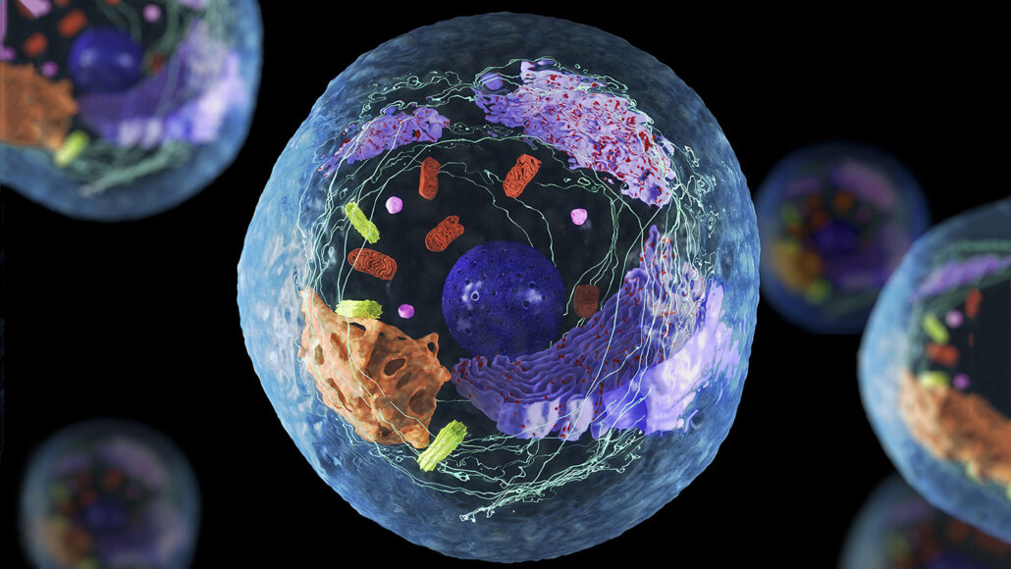
functional awareness/ responsiveness

Slide 5
subjective experience (The “conscious cutoff”)

Slide 6
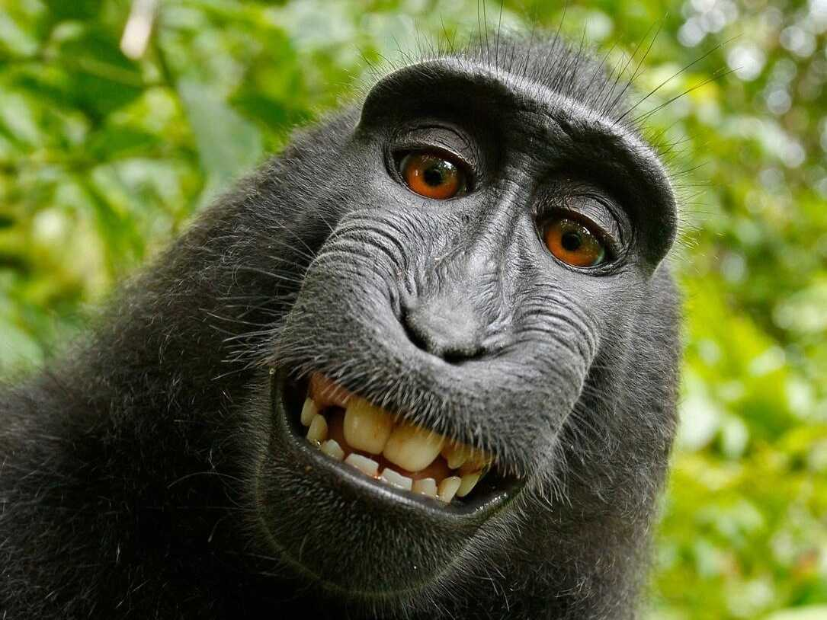
self-consciousness

Slide 7
other human specialties
Language
Brain size
Tool usage

Slide 8
Can AI be conscious?

Slide 9
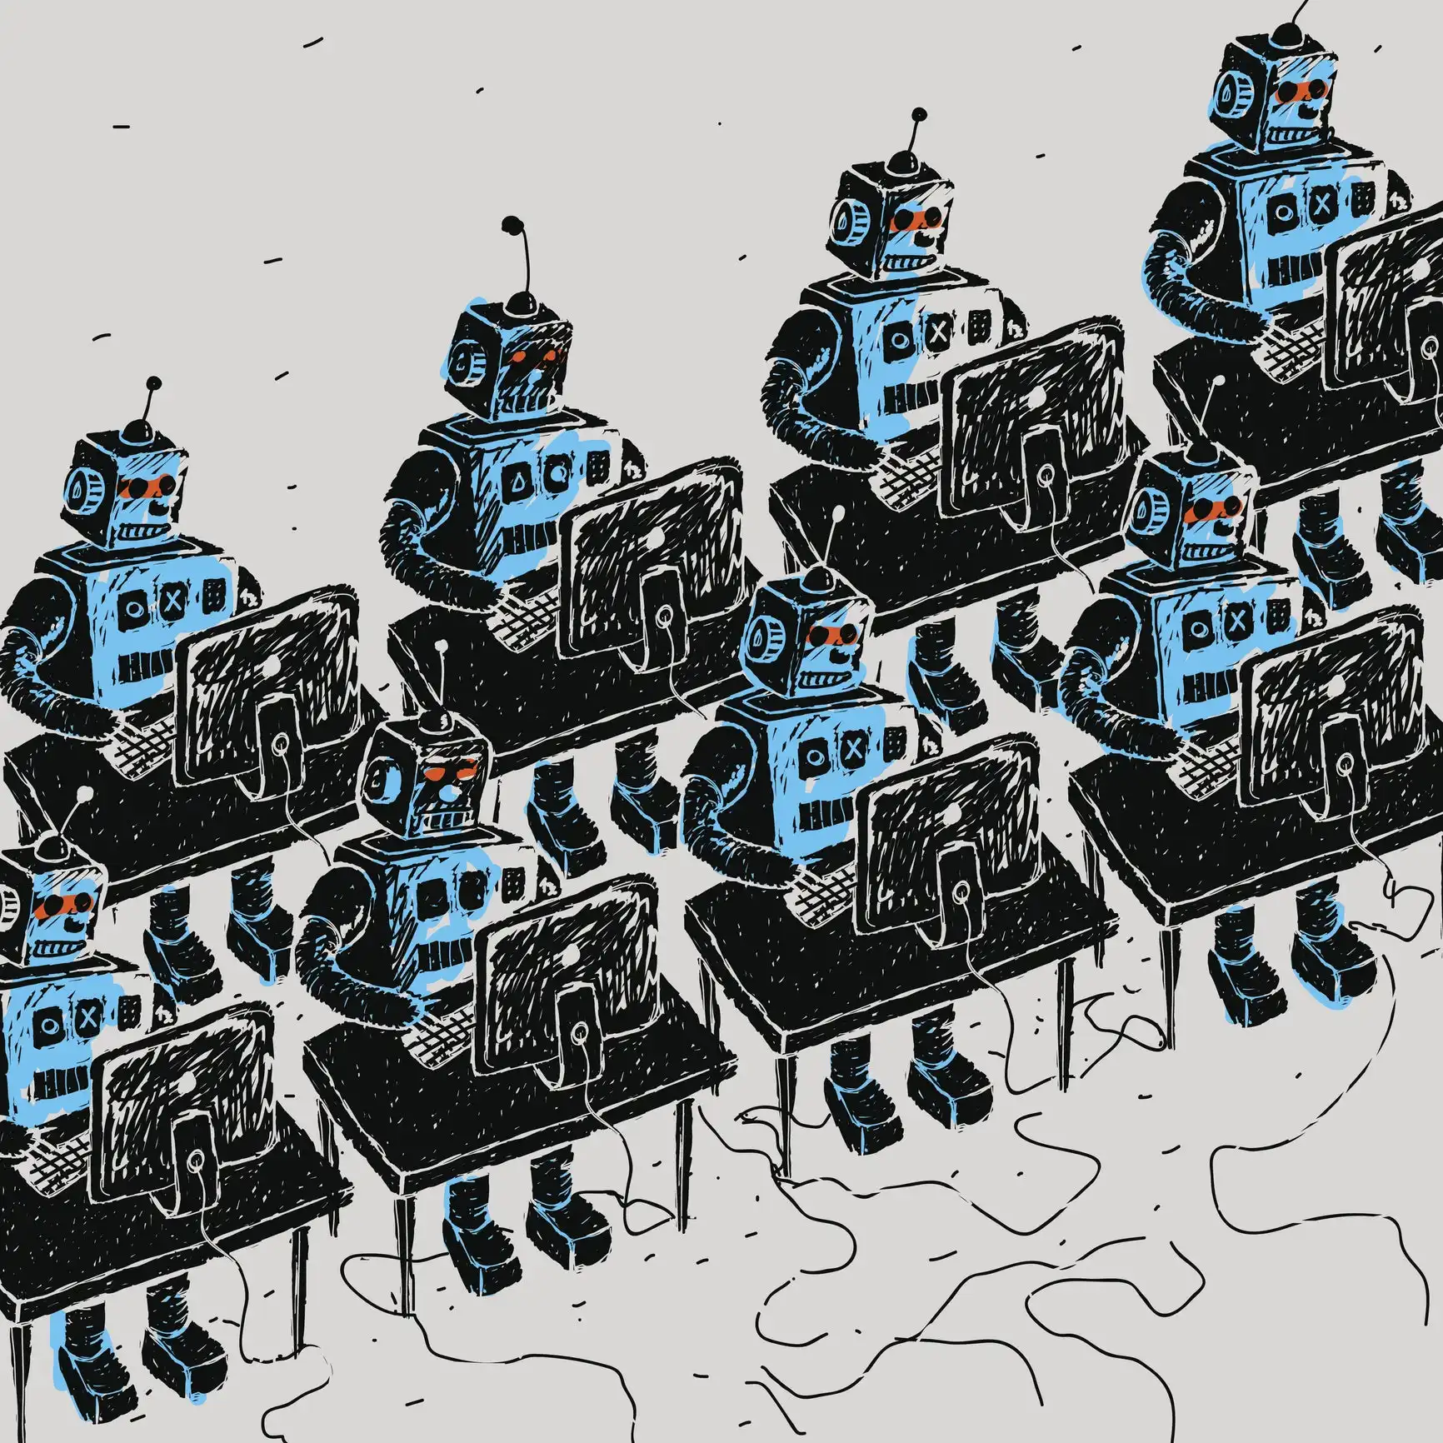
If AI is Conscious, can we still ethically use it?

Slide 10
Shared basis of ethics

Slide 12
Shared basis of ethics

Slide 13
Infinite Heroine Machine

Slide 14
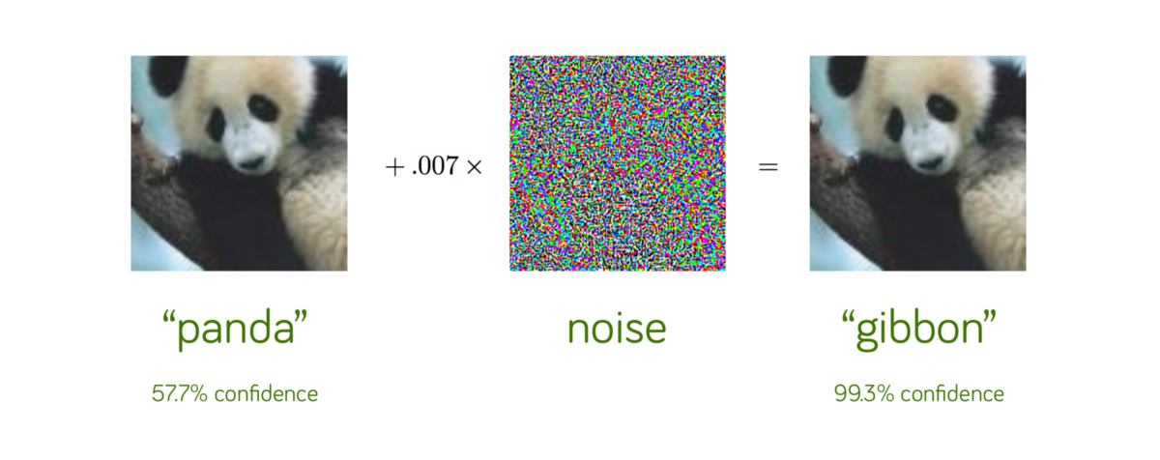
Adversarial Well-Being
HEROINE
You
+
Noise
=
Infinite Heroine

Slide 15
Infinite Heroine AI

